Slide 1
Table of Contents
Chapter 7: Elements
Trends
History
Properties

Slide 2
Table of Contents
Chapter 7: Elements
One more Trend

Slide 3
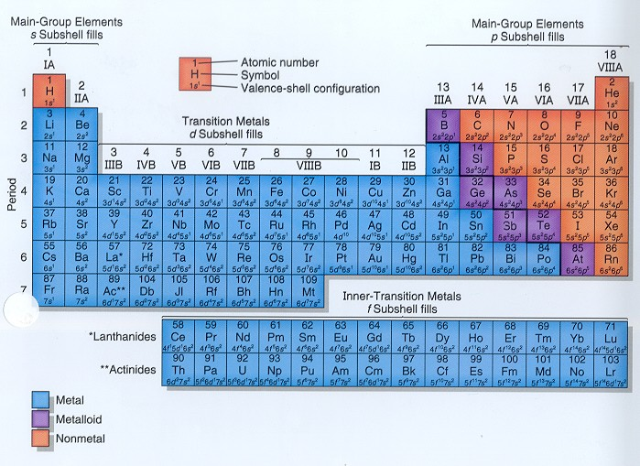
A couple more trends
Reactivity
Less reactive
More reactive
Less reactive
More reactive
More reactive
Less reactive
More reactive
Less reactive
Metals: follow atomic radii: bigger atoms, more reactive
Non-metals: follow electronegativity: “stealing power”

Slide 4
Table of Contents
Chapter 7: Elements
History

Slide 5
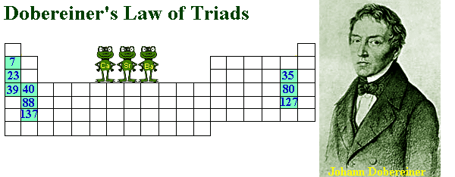
Periodic Table: Basic Concepts
Döbereiner’s Triads
What these trends tell us:
J.W. Döbereiner – 1829 – triads of elements with similar properties.

Slide 6
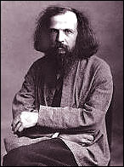
Periodic Table: Basic Concepts
Mendeleev’s Periodic Table
Mendeleev - improved version of his table
same number of valence electrons
similar properties
Elements in a period (horizontal row) have different properties.
Elements in the same group (vertical column):

Slide 7
Periodic Table: Basic Concepts
The Modern Periodic Table
So…elements in the periodic table are in order by
atomic number
number of electrons

Slide 8
Periodic Table: Basic Concepts
The Modern Periodic Table
Periodic law: physical and chemical properties of the elements repeat in a regular pattern when they are arranged in order of increasing atomic number.
Periodicity: the tendency to recur at regular intervals.

Slide 9
Table of Contents
Chapter 7: Elements
Properties

Slide 10
Elements: Basic Concepts
Periodic Properties of the Elements
Understanding the relationship between…
electron configuration &
position in the periodic table
enables you to …
predict the properties of the elements &
predict the outcome of many chemical reactions.

Slide 11
Periodic Table
Review
Elements & ions react to try to become more stable – like noble gases
1 2 3 4 5 6 7 8
ALKAL
I
METALS
ALKAL
I
NE
EARTH
NOBLE
GASES
HALOGENS
Metalloids
Transition
Metals
Lanthanoids
Actinoids

Slide 12
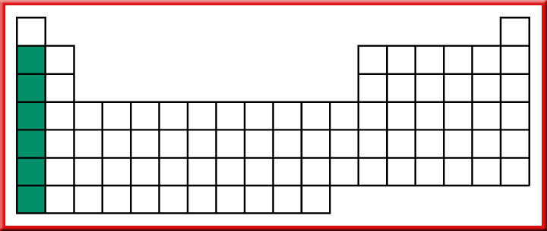
Elements: Basic Concepts
The Alkali Metals
Very reactive - combined in nature
Forms 1+ ion

Slide 13
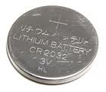
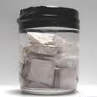
The Alkali Metals
Lithium – lightest, batteries
Sodium & Potassium: most abundant
Used in growth of humans & plants
fireworks
Others: little commercial use

Slide 14
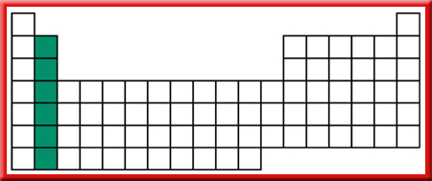
Elements: Basic Concepts
The Alkaline Earth Metals
Very reactive - combined in nature
Forms 2+ ion

Slide 15
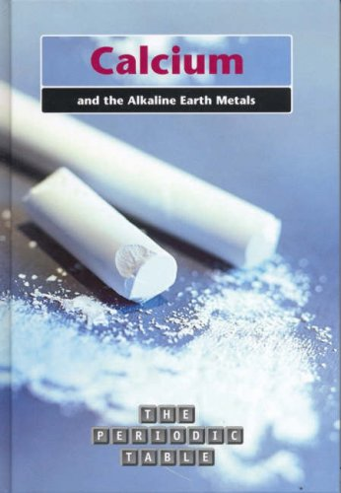
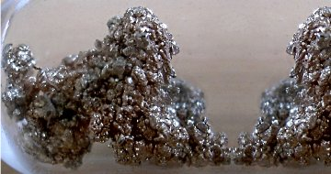
The Alkaline Earth Metals
Calcium – bones, teeth, chalk, marble, coral
Magnesium – bike/backpack/car frames
Muscle function, metabolism
Others: other random use

Slide 16
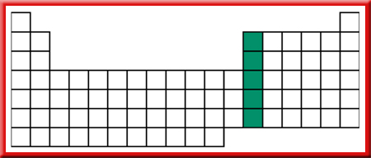
Elements: Basic Concepts
Group 13 Elements
not as active as the metals in Groups 1 and 2
good conductors of heat and electricity
Aluminum: 3+ ion

Slide 17
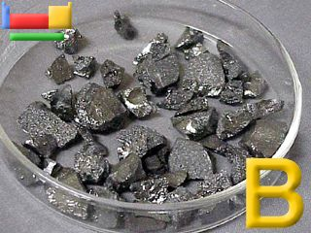
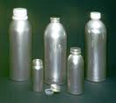
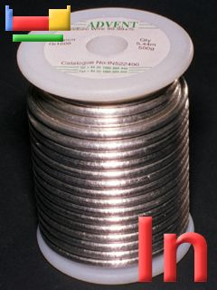
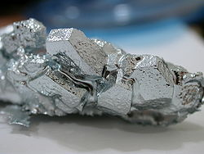
Group 13 elements
Boron – cleaning agents, insulation
Aluminum – most abundant metal
Gallium: 1 of its alloys is an excellent semiconductor
http://www.disappearingspoons.com/

Slide 18
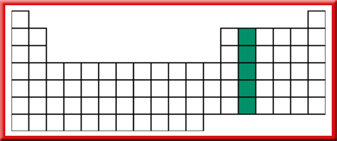
Elements: Basic Concepts
Group 14 Elements
carbon is a nonmetal (forms 4± ions)
silicon and germanium are metalloids
tin and lead are metals

Slide 19
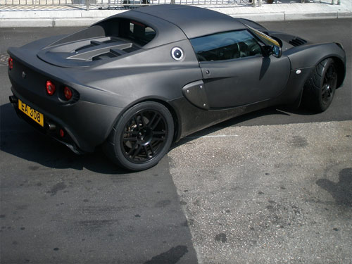
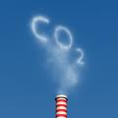
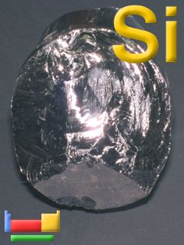
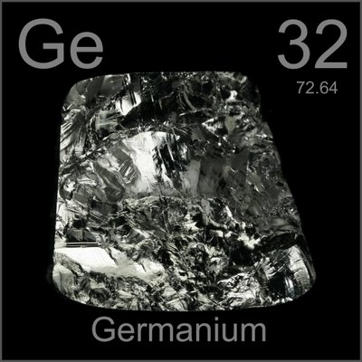
Group 14 elements
Carbon: incredibly important – has its own branch of chemistry (organic)
Allotrope: forms of an element that have different structures and properties (graphite, diamond)
Silicon: computer chips, solar cells, very abundant

Slide 20
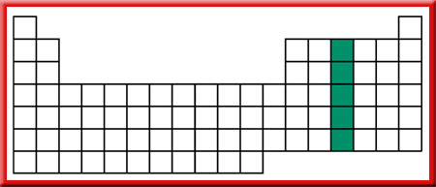
Elements: Basic Concepts
Group 15 Elements
Nitrogen: forms 3- ions
Bismuth: forms 3+ ions
Properties become more metallic as you descend the period

Slide 21
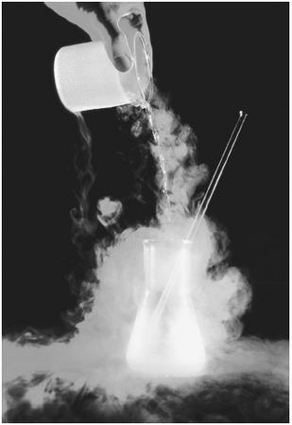
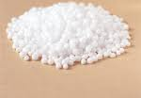
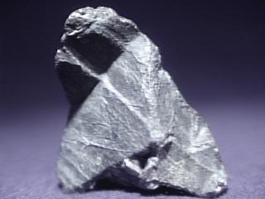
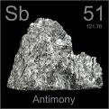
Group 15 elements
Nitrogen: tons in air, but plants must get it from nitrogen-fixing bacteria
Used to create ammonia (NH₃): fertilizer, dyes, explosives, etc
Phosphorus: fertilizer

Slide 22
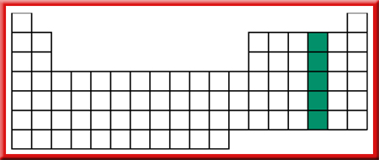
Elements: Basic Concepts
Group 16 Elements
Forms 2- ions
Oxygen reacts with both metals and nonmetals
2nd most reactive non-metal

Slide 23
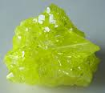
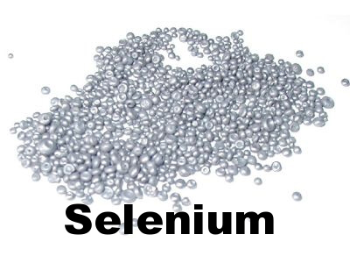
Group 16 elements
Oxygen: most abundant element in Earth’s crust 2 allotropes: ozone(O₃), O₂
Sulfur: fertilizers, paints
works to prevent cell damage

Slide 24
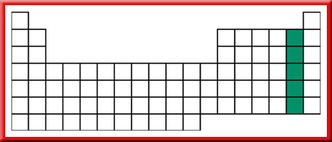
Elements: Basic Concepts
Group 17 Elements: Halogens
Active nonmetals
Because of their chemical reactivity, they don’t exist as free elements in nature
Gains 1 electron: forms 1- ion

Slide 25
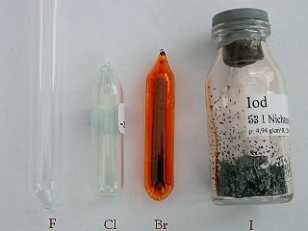
Group 17 elements
Fluorine: most reactive
Chlorine: bleaching & cleaning agents
Iodine: kills bacteria

Slide 26
Elements: Basic Concepts
Group 18 Elements: Noble Gases
originally called the inert gases because chemists couldn’t get them to react
Very stable – full octet

Slide 27
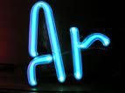
Noble Gases
Helium: blimps, airships, balloons, SUN
Neon: light displays
Argon & Krypton: prolong the life of filaments

Slide 28
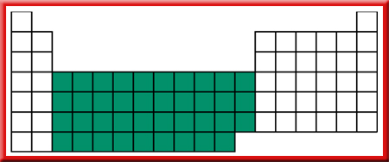
Elements: Basic Concepts
Transition Metals
higher melting & boiling points (exceptions: zinc, cadmium, mercury)
multiple oxidation states (ions with differing charges) – because of involvement of the d electrons in bonding
Zinc: 2+ ion Silver: 1+ ion

Slide 29
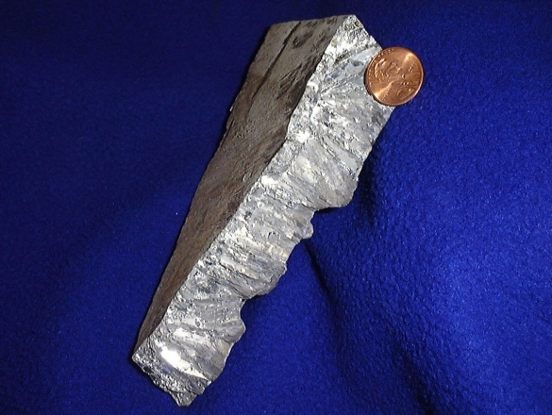
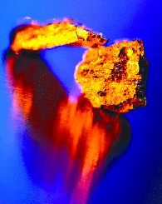
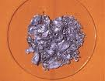
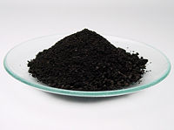
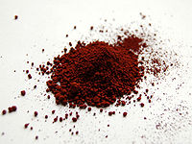
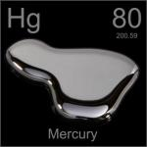
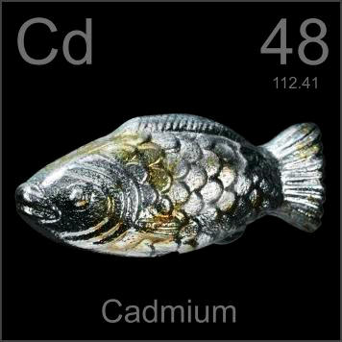
Transition metals
Magnets (iron), jet engines, drill bits, surgical instruments, iron, plastics, petroleum, food, etc.
Alloys: a mixture of elements that has metallic properties

Slide 30
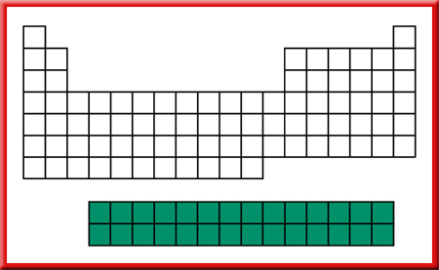
Elements: Basic Concepts
The Inner Transition Elements: Lanthanides
Electrons of highest energy are in the 4f sublevel
once called rare earth elements
Why? Because all of these elements occurred in Earth’s crust as “earths”, an older term for oxides, and seemed to be relatively rare

Slide 31
Elements: Basic Concepts
The Inner Transition Elements: Actinides
The highest-energy electrons in the actinides are in the 5f sublevel

