Slide 1
Progression
Orbital Filling

Slide 2
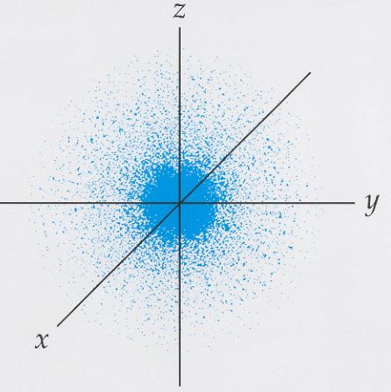
32
4
18
3
8
2
s oribtal
1s
(2 e⁻)
2
1
Nuc

Slide 3
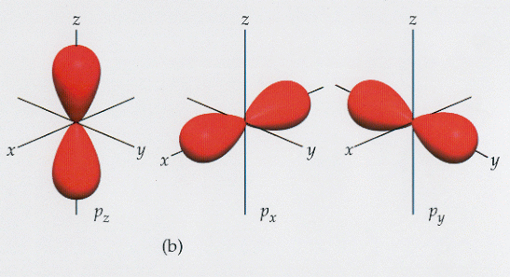
32
4
Pauli exclusion principle: Only 2 electrons per orbital
p oribtals
18
3
2p
6 e⁻
8
2
2s
2 e⁻
1s
2 e⁻
2
1
Nuc

Slide 4
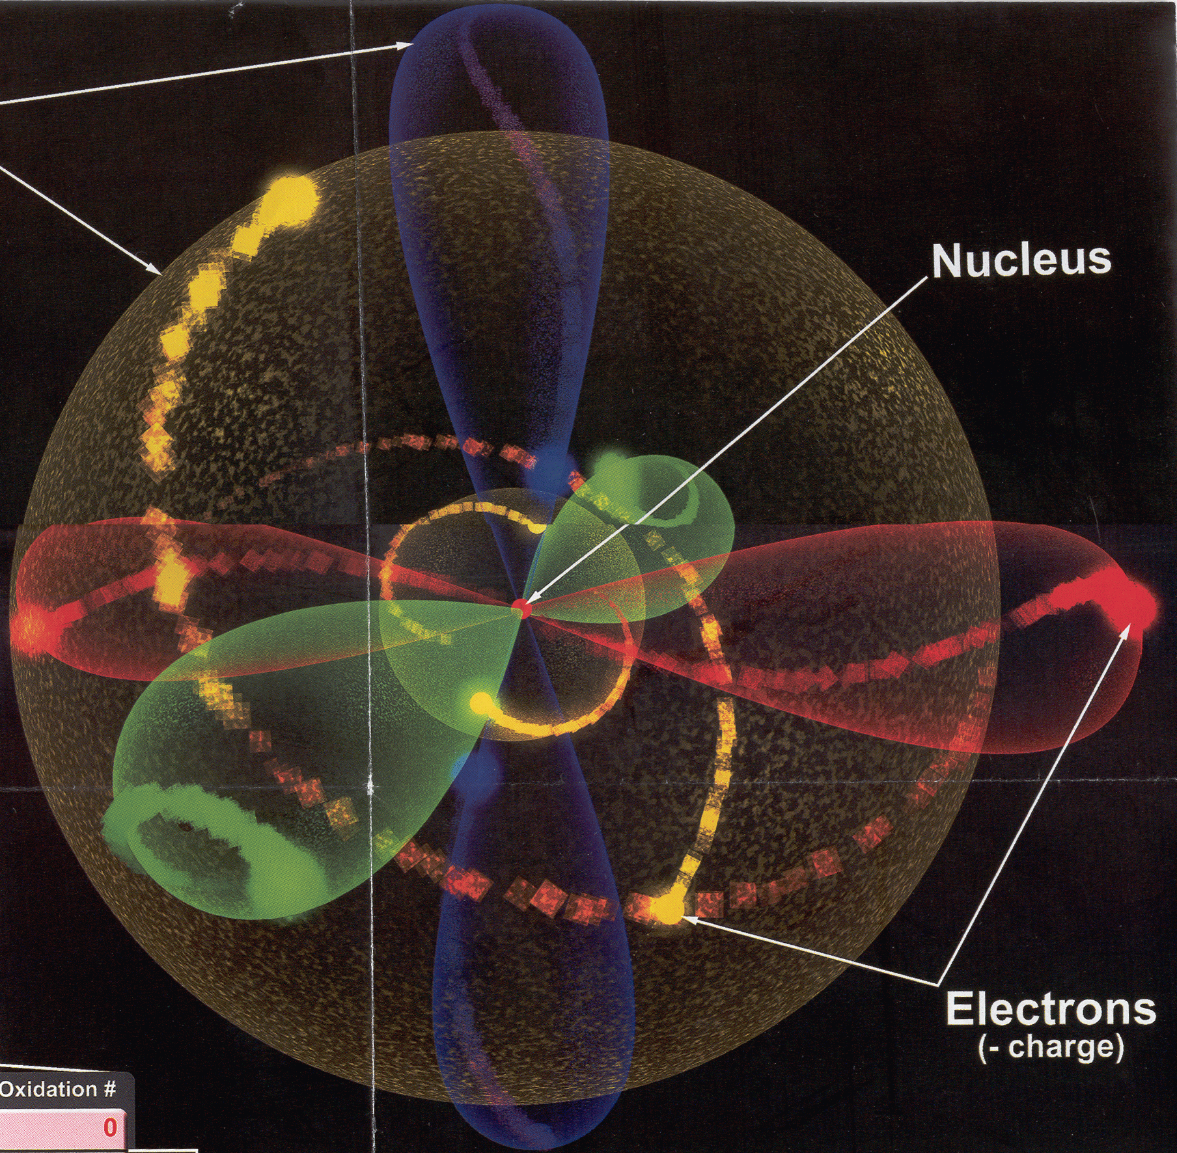

Slide 5
size shape orientation
d oribtals
32
4
3d
10 e⁻
18
3p
6 e⁻
3
3s
2 e⁻
8
2p
6 e⁻
2
2s
2 e⁻
2
1s
2 e⁻
1
Nuc

Slide 6
n-size l-shape m-orientation
4f
14 e⁻
4d
10 e⁻
32
4p
6 e⁻
4
3d
10 e⁻
4s
2 e⁻
18
3p
6 e⁻
3
3s
2 e⁻
8
2p
6 e⁻
2
2s
2 e⁻
2
1s
2 e⁻
1
Nuc

Slide 7
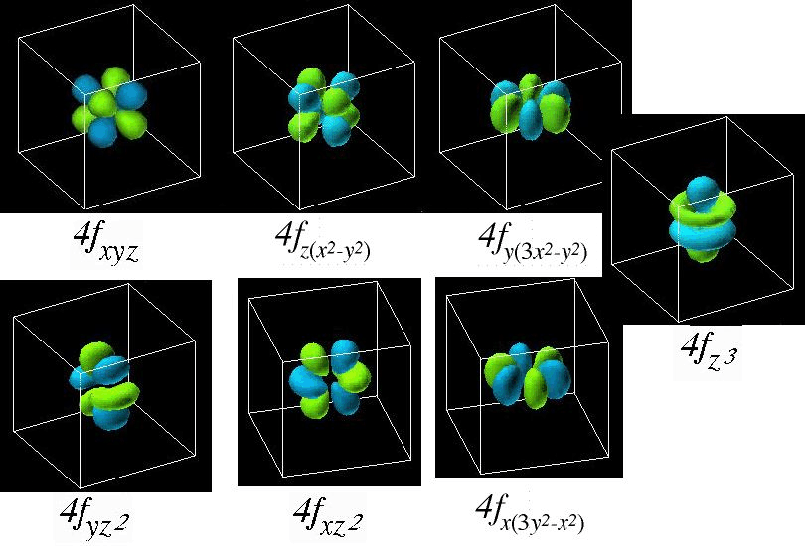
f oribtals

Slide 8
size shape orientation
4f
14 e⁻
4d
10 e⁻
32
4p
6 e⁻
4
3d
10 e⁻
4s
2 e⁻
18
3p
6 e⁻
3
3s
2 e⁻
8
2p
6 e⁻
2
2s
2 e⁻
2
1s
2 e⁻
1
Nuc

Slide 9
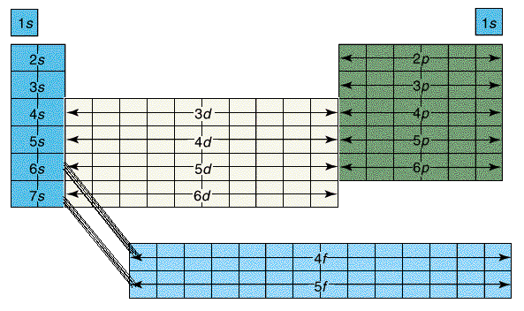
The periodic Table can help us figure out what order the electrons fill in…
s
1
2
3
4
5
6
7
p
d (-1)
f (-2)
Fill across the table, then down – like you’re reading
s & p blocks are also called “representative elements”

Slide 10
Quantum Numbers
Representing electron structures
Orbital Filling Diagrams – we’ll look at…
Oxygen
Copper
Promethium
Tungsten

Slide 11
Quantum Numbers
Oxygen
1s
2s
2p
Hunds’ rule: e⁻ don’t share orbitals if they don’t have to
Aufbau Principle: fill up levels closest to nucleus 1st

Slide 12
Quantum Numbers
Copper
1s
2s
2p
3s
3p
4s
3d
EXCEPTION: Copper & Chromium fill a full or ½ full d orbital before the s orbital (often more stable

Slide 13
Quantum Numbers
Promethium
1s
2s
2p
3s
3p
4s
3d
4p
5s
4d
5p
6s
4f

Slide 14
Quantum Numbers
Tungsten
1s
2s
2p
3s
3p
4s
3d
4p
5s
4d
5p
6s
4f
5d

Slide 15
Try it out!
1) Lithium
1s 2s
2) Carbon
1s 2s 2p
3) Fluorine
1s 2s 2p
4) Magnesium
1s 2s 2p 3s

Slide 16
5) Phosphorus
1s 2s 2p 3s 3p
6) Arsenic
1s 2s 2p 3s 3p
4s 3d 4p
7) Potassium
1s 2s 2p 3s 3p
4s

Slide 17
8) Iron
1s 2s 2p 3s 3p 4s 3d
4p 5s 4d
9) Tungsten
1s 2s 2p 3s 3p 4s 3d
4p 5s 4d 5p 6s
4f 5d
10) Iodine
1s 2s 2p 3s 3p 4s 3d
4p 5s 4d 5p

