Slide 1
Progression
Quantum Intro

Slide 2
Today!
Only write down stuff in blue boxes, and feel free to summarize the blue box stuff as well
Like this

Slide 3
A little more about Electromagnetic Waves
All e.m. waves travel at the speed of light (c) or 300,000,000 meters/second (3x10⁸)
The speed of a wave is wavelength (λ)times frequency (ν) so, for all e.m. waves C = λ ν

Slide 4
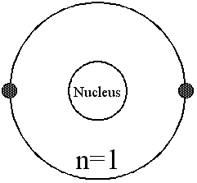
Bohr Model
Tried to describe e⁻ as little particles revolving around nucleus
Depended on his ability to track electrons
Used a single variable to describe the size of the orbit

Slide 5
Heisenberg uncertainty principle:
It is impossible to know the exact position and momentum of an electron
In other words…we can’t know exactly where an electron is and where it is going
Because…why?

Slide 6
The Schrödinger wave equation
1926 - Erwin Schrödinger: derived an equation that treated the hydrogen atom’s electron as a wave.
Applied to other elements, not just H
The quantum/wave mechanical model: atomic model where electrons are treated as waves

Slide 7
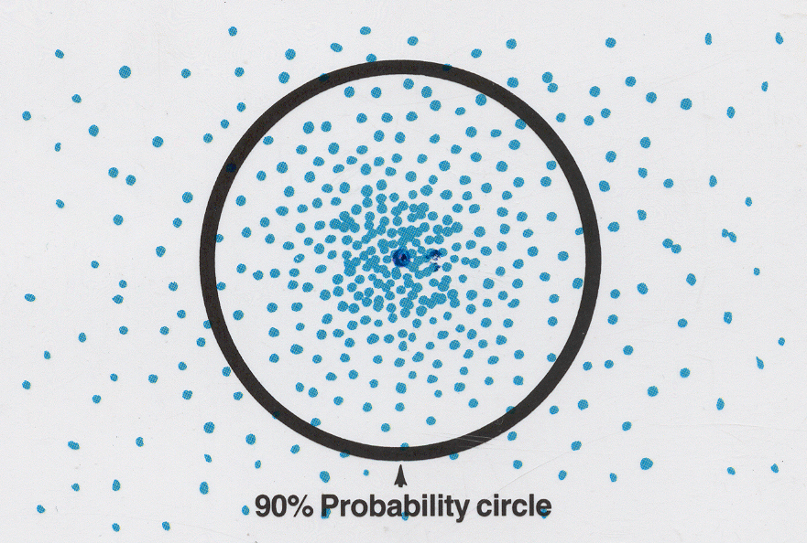
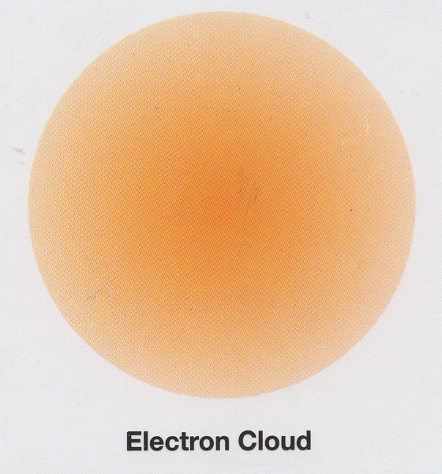
The Schrödinger wave equation
Probability
Ability to know where an e⁻ is most of the time
Treats electrons as if they occupy the whole space, rather than as points along a path
“Electron clouds” = orbitals

Slide 8
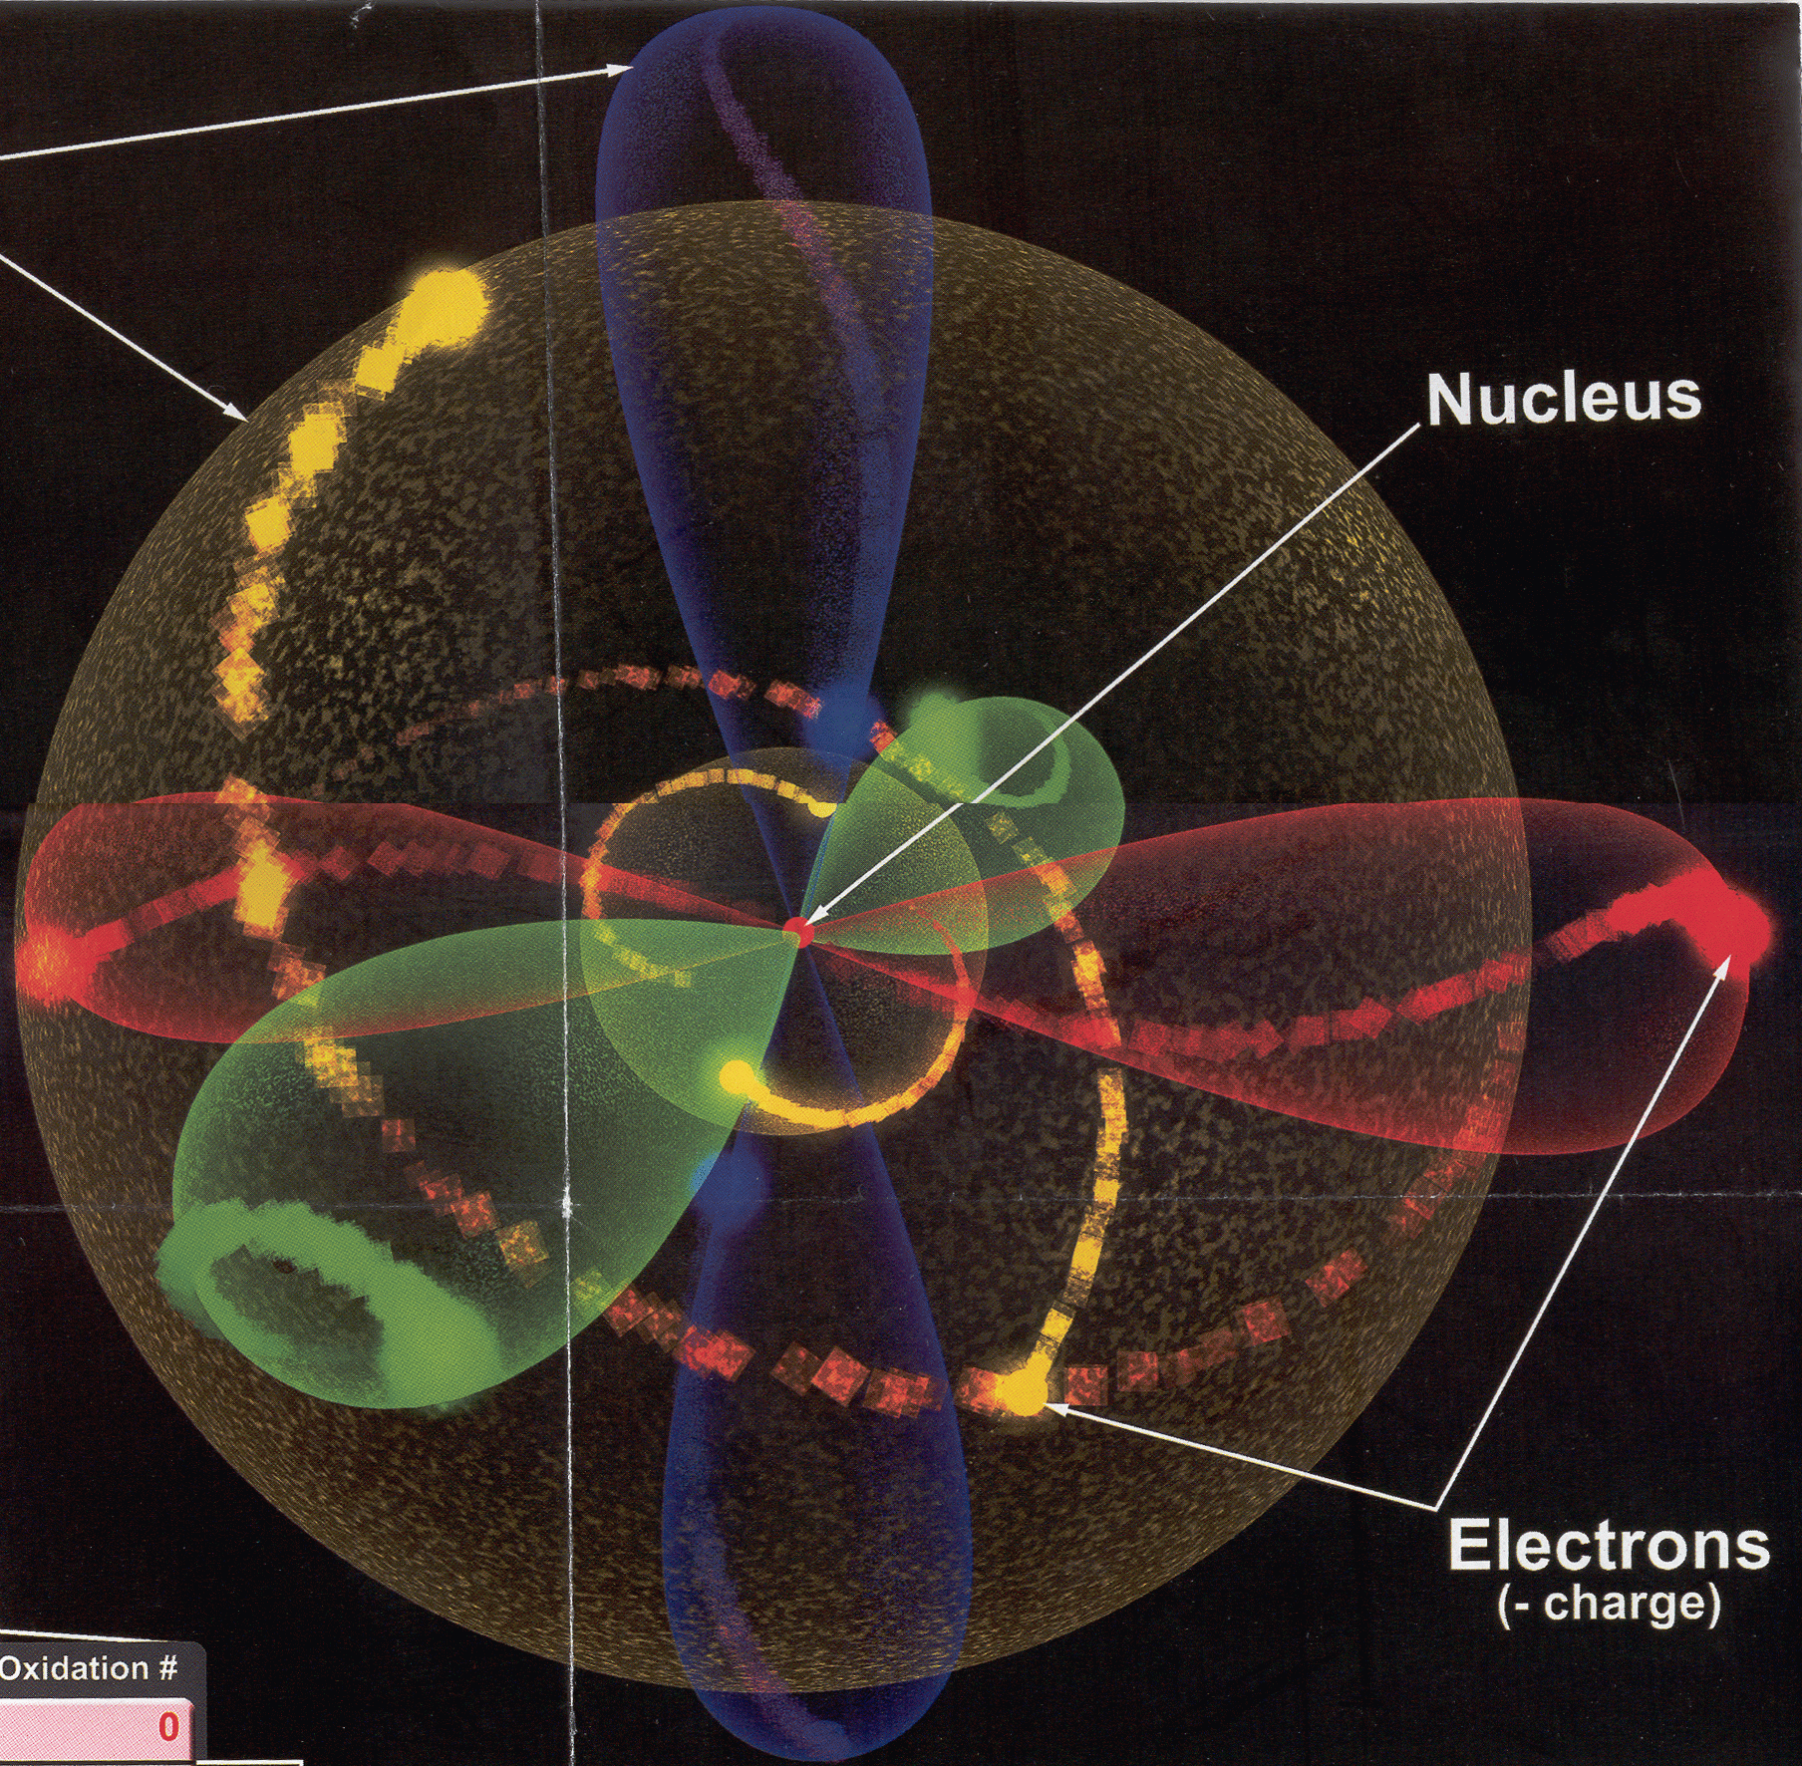
Probability
Orbitals are more like cloud than orbits
Not always spherical

Slide 9
Quantum numbers – numbers used to describe the spaces electrons occupy
Principle Quantum Number (n) – size
As n goes up…
Size increases
Energy increases

Slide 10
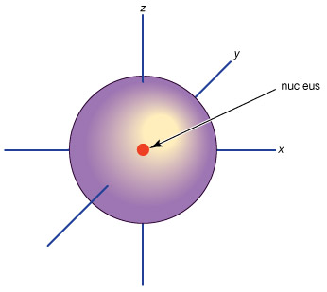
s orbitals
First appear in the 1st energy level (n=1)
Can hold 2 electrons
Sphere shaped

Slide 11
p orbitals
First appear in the 2nd energy level (n=2)
Come in sets of 3
Each can hold 2 electrons (6 total)
Dumbell shaped

Slide 12
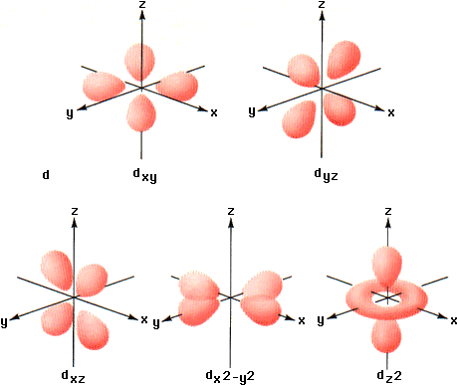
d orbitals
First appear in the 3rd energy level (n=3)
Come in sets of 5
Each can hold 2 electrons (10 total)
Crazy shaped

Slide 13
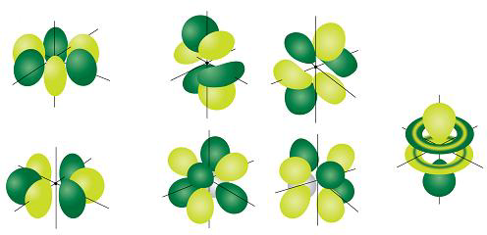
f orbitals
First appear in the 4th energy level (n=4)
Come in sets of 7
Each can hold 2 electrons (14 total)
Crazier shaped

Slide 14
To summarize
Orbital | # sets | Total e⁻
s | 1 | 2
p | 3 | 6
d | 5 | 10
f | 7 | 14

Slide 15
To summarize
Energy levels
Orbitals
Total e⁻
n=4
s
p
d
f
e⁻=32
n=3
s
p
d
e⁻=18
n=2
s
p
e⁻=8
n=1
s
e⁻=2

Slide 16
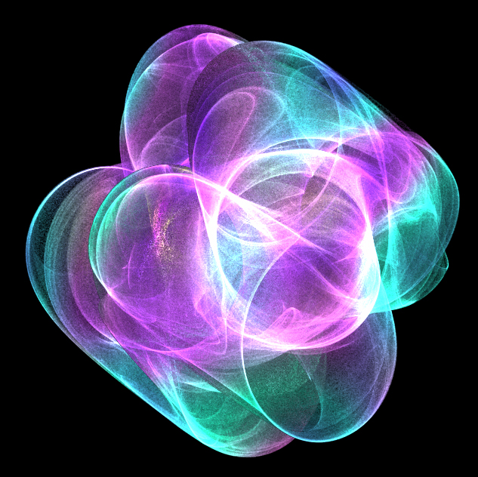
Le fin

