Slide 1
Types of Bonding
Objectives:
1. Ionic Bonding
2. Metallic Bonding
3. Ionic & Metallic naming

Slide 2
Chemical Bonding
Review:
Chemical bonds are attractive forces (electrostatic attractions) which hold atoms together to form compounds
Types of bonds:
Ionic: Metal with a Non-metal
Covalent: Non-metal with a Non-metal
Metallic: Metal with a Metal

Slide 3
Chemical Bonding
Metal with a Non-Metal
What are the chemical properties of metals? (think trends)
What are the chemical properties of non-metals?
What do you think will happen when they react together?

Slide 4
Chemical Bonding
Metal with a Non-Metal
Ionic Bonding
A strong non-metal anion (-) steals electrons from a weak metal cation (+) to form ions
Big electronegativity difference (between cation and anion)
Ions then form ionic compounds

Slide 5
Chemical Bonding
Metal with a Non-Metal
Ionic Bonding
Full octet
Full octet
NaCl = formula unit (simplest ratio)
no charge

Slide 6
Chemical Bonding
Metal with a Non-Metal
Ionic Bonding
Oxidation number = the charge on the ion
Comes from gaining or losing ions
Polyatomic ions:
An ion that has several different elements
A group of elements with a charge

Slide 7
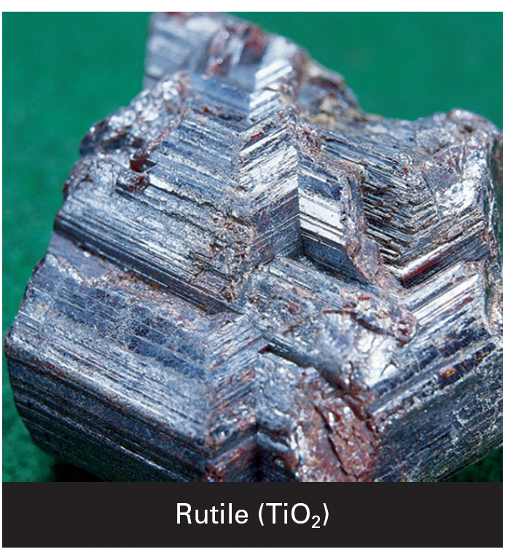
Chemical Bonding
Some properties of ionic compounds:
Most ionic compounds are crystalline solids at room temperature
(+) & (-) ions surround each other to form a crystal lattice
Orderly arrangement → high melting & boiling points, brittleness

Slide 8
Chemical Bonding
Some properties of ionic compounds:
Solids = insulators
liquid/gas = conductors
Salts = electrolytes:
Ionic substances which dissolve in water
They conduct electricity

Slide 9
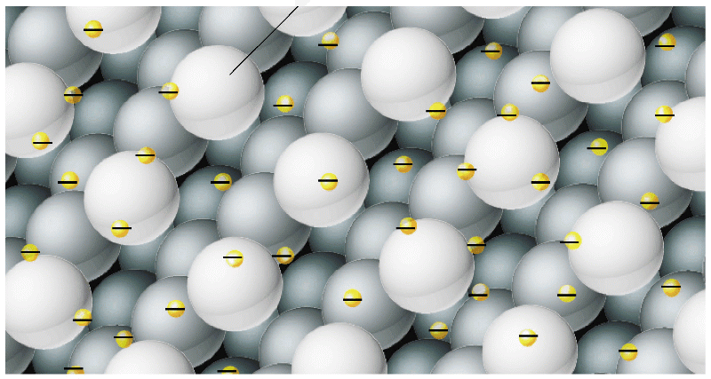
Chemical Bonding
Metal with a Metal
The valence electrons of metal atoms can be modeled as a sea of electrons.
Delocalized electrons: e- that are free to move in metals
The valence electrons are mobile and can drift freely from one part of the metal to another.
Metallic bonds consist of the attraction of the free-floating valence electrons for the positively charged metal ions.

Slide 10
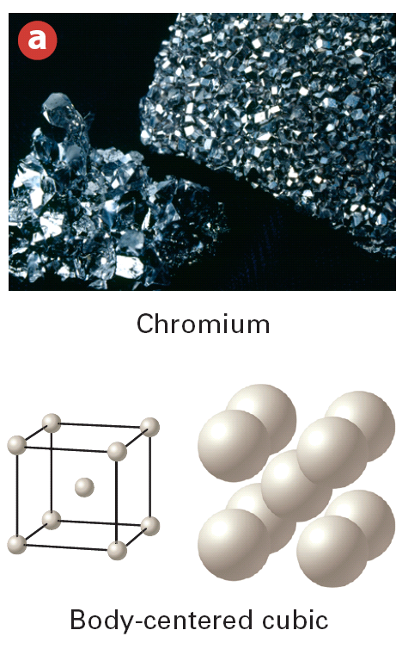
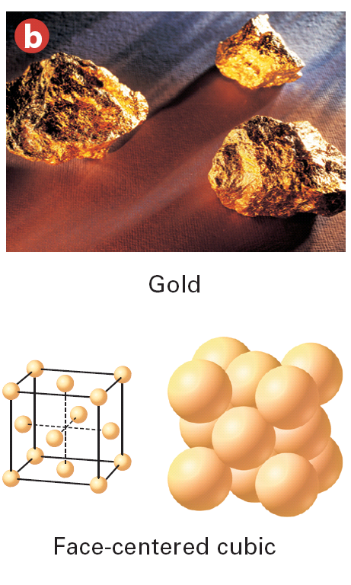
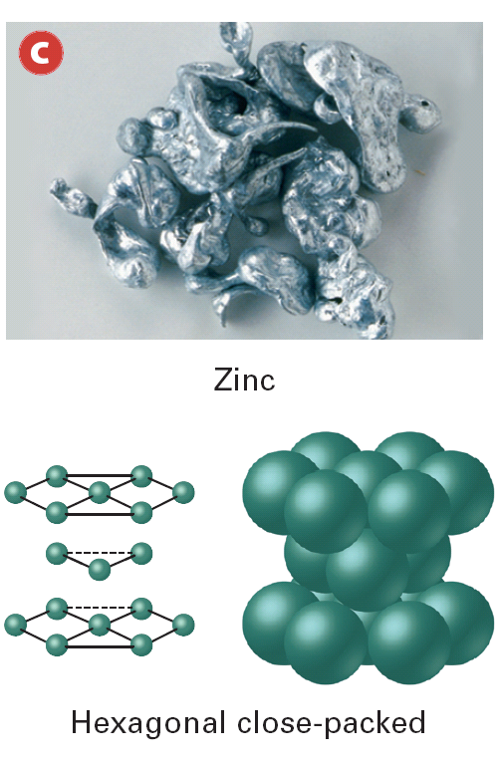
Chemical Bonding
Metal with a Metal
Metal atoms are arranged in very compact and orderly patterns

