Slide 1
The Wave Nature of Light

Slide 2
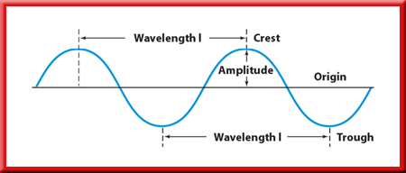
The Wave Nature of Light
A bit about waves
λ, lambda
Frequency (ν, nu) is the number of “waves” that pass a given point per second.

Slide 3
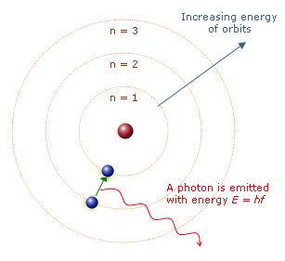
The Wave Nature of Light
Light emission
When an electron absorbs energy from its surroundings, it jumps into a larger orbit
Excited state
Requires absorption of energy
Energy can come from many forms
Electricity, Radiation, Light, Heat

Slide 4
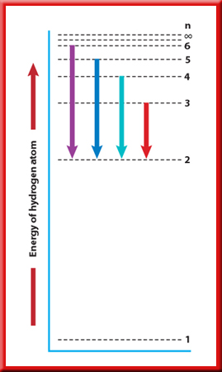
The Wave Nature of Light
Light emission
When this electron loses that energy it returns to its original orbital
Ground State
Energy is released in the form of light

Slide 5
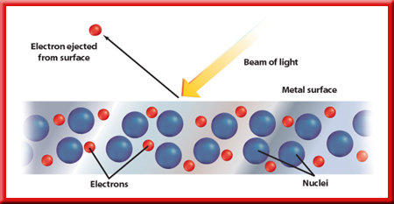
The Wave Nature of Light
Light emission
What determines how much energy is released?
1900 – Max Planck
Photoelectric effect: electrons are emitted from a metal’s surface when light of a certain frequency shines on the surface.
Matter can gain or lose energy only in small, specific amounts - packets (quanta).
A photon: a particle of electromagnetic radiation with no mass that carries a quantum of energy.
A quantum: the minimum amount of energy that can be gained or lost by an atom.

Slide 6
The Wave Nature of Light
Light emission
How do we observe these differences?
The atomic emission spectrum of an element is the set of frequencies of the electromagnetic waves emitted by atoms of the element.
characteristic of the element examined
can be used to identify that element.
only certain colors → only specific frequencies of light are emitted

Slide 7
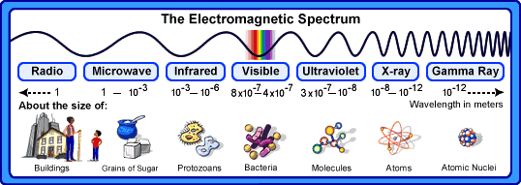
The Wave Nature of Light
ROYGBIV
Low to High Energy
Long to Short Wavelength

